Slide 1
VoIP Penetration Testing: Lessons Learned, Tools and Techniques
Jason Ostrom Sr. Security Consultant
John Kindervag, CISSP, QSA Sr. Security Architect

Slide 2
Agenda
Security and the Converged Network
The Business Risk
VoIP Attack Vectors
VoIP Hopping Attacks
The VoIP Hopper Tool
Live Demonstration

Slide 3
Security and the Converged Network
Convergence – Multiple Types of Information on same Pipe
Voice
Data
Video
Less Cabling
Simplify Moves/Adds/Changes
Toll Bypass
You can get your Voice Mail in you Inbox!
But what about Security?

Slide 4
The Business Risk
Low Awareness as to Security Threats
Publicly Accessible IP Phones
Waiting Areas
Conference Rooms
Hotel Rooms
Can an Attacker Gain Privileged Access?

Slide 5
The Business Risk
The Voice VLAN
Allows IP Phones to auto-configure
Phones easily associate to a logically separate VLAN
Allow simultaneous access for a regular PC

Slide 6
Voice VLAN

Slide 7
VoIP Assessment
“You can’t access our corporate data network from the IP Phones."
VoIP Vulnerability Assessment
Controls Validation
Gained Administrator access to servers in the data center
Remote, physically isolated location where the IP Phones were located and believed to be “secure”.

Slide 8
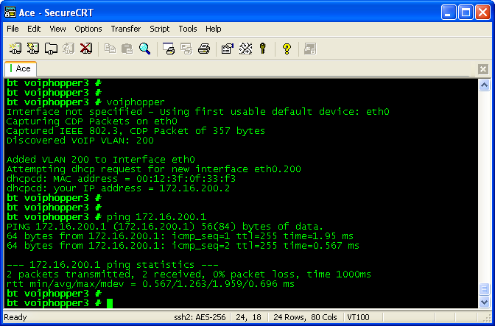
The VoIP Hopper Tool

Slide 9
Live Demonstration

Slide 10
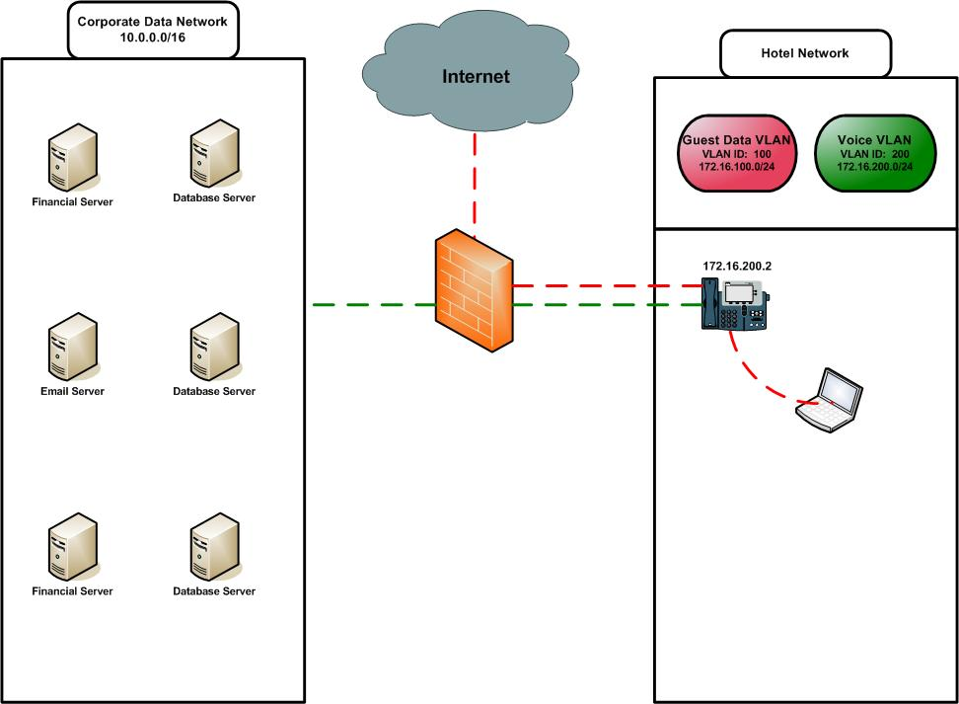
Customer VoIP Network

Slide 11
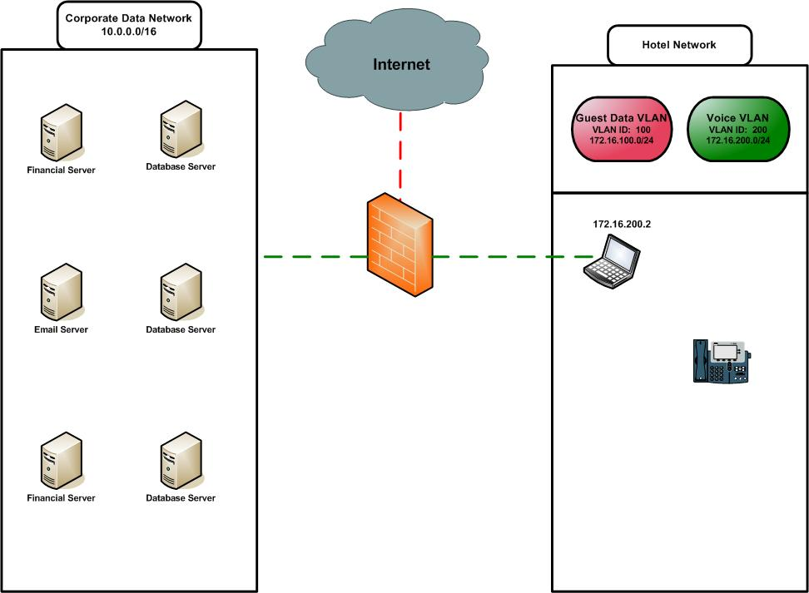
How this happens

Slide 12
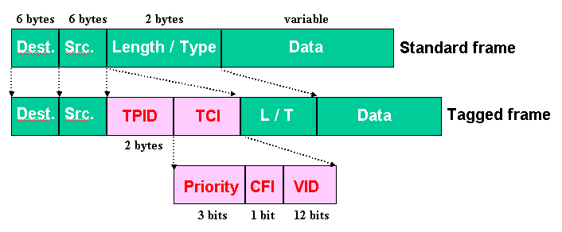
Create a new VLAN Interface on the PC

Slide 13
Clarify Risks
This is about:
Network Infrastructure Security
Poor Network Design
Not About:
Exploiting Cisco Unified Communication Manager platform
Exploiting Avaya platform

Slide 14
VLAN Hopping Risks
DoS against IP Phones
Attacking open ports/services on CallManager platform
Gaining access to internal network resources when no firewall is in place
VoIP Hopper doesn’t enable Sniffing / Eavesdropping on calls

Slide 15
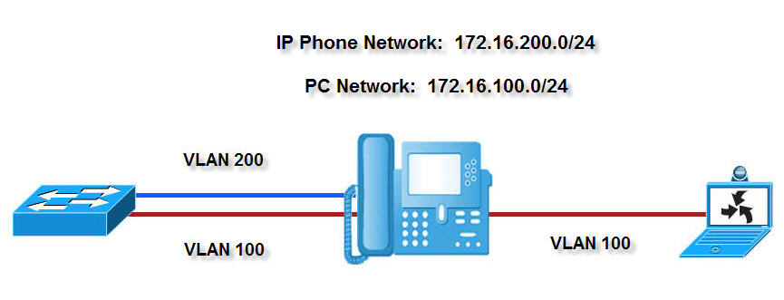
Demo Setup and IP Addressing

Slide 16
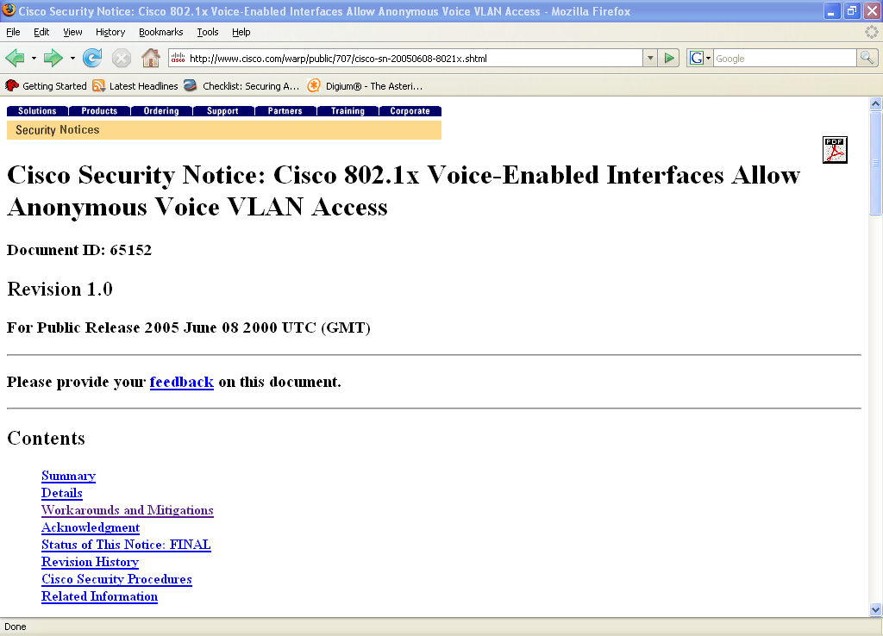
Cisco 802.1x Voice Enabled Ports Credit: Jamal Pecou

Slide 17
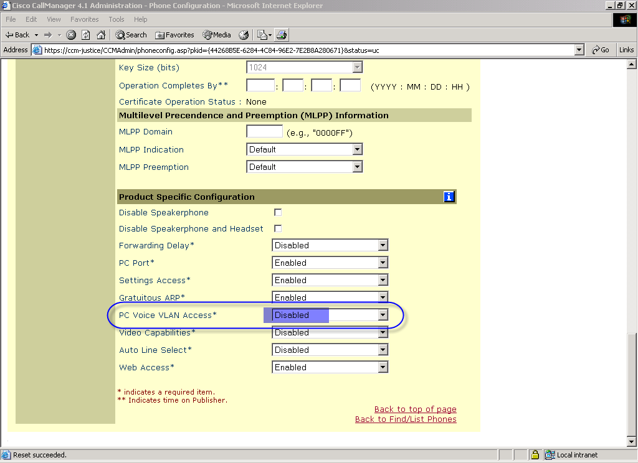
Mitigation of VLAN Hop from Port 2 of IP Phone
Notes:
The first way is by disabling the PC Voice VLAN Access feature on the IP Phone

Slide 18
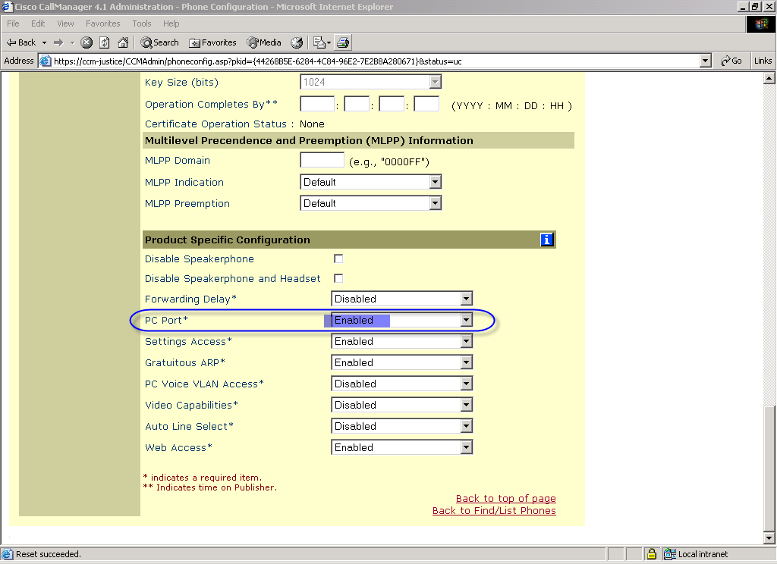
Mitigation of VLAN Hop from Port 2 of IP Phone
Notes:
The second way is to disable the PC Port.

Slide 19
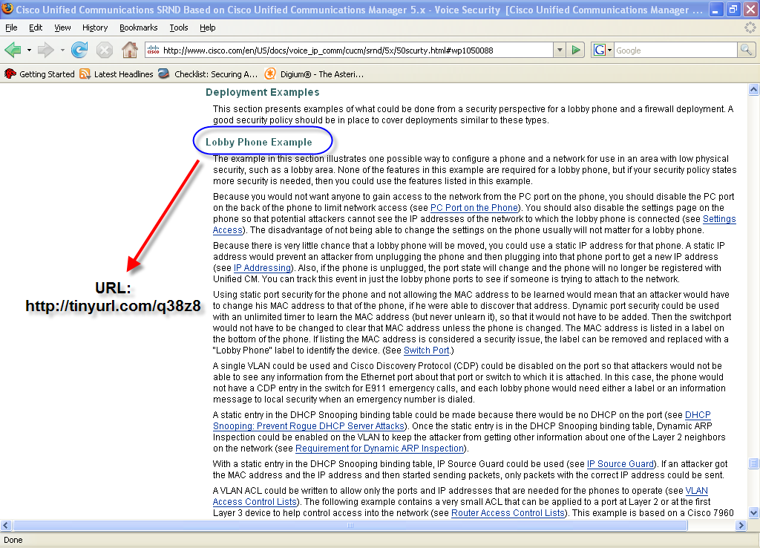
Lobby Phone Deployment Cisco Recommendations

Slide 20
Hiding & Filtering MAC Address?
Placing a hub between the IP Phone and wall, an attacker can sniff the MAC Address. This bypasses Administrator attempts to hide the MAC Address by removing the sticker or locking the Phone settings.
Physical Security of the IP Phone switchport

Slide 21
Phone CDP Security: Is it the Answer?
A new Cisco IOS Feature available in 12.2.36 SE and later
Uses Line Power, CDP, and Full Duplex to only allow the Cisco Unified IP Phone Voice VLAN traffic
Port goes into err-disable when a PC is attached directly to the port.

Slide 22
Can be bypassed
Scenario 1: With only Phone CDP Security enabled, plug into PC Port on IP Phone and run VoIP Hopper.
Scenario 2: Customer has disabled PC Port on their IP Phones and Phone CDP Security is enabled. When MAC Address filtering is not implemented, a rogue IP Phone can be brought into the environment, and used to gain access to Voice VLAN.

Slide 23
Mitigate VLAN Hopping (Cisco)
1. Phone CDP Security
2. MAC Address filtering to only allow MAC of IP Phone on switchport
3. Disable PC Port, and/or PC Voice VLAN Access

Slide 24
VoIP Hopper future
Ethernet card supporting PoE
Fix DHCP code
New DHCP Option for Avaya
Alcatel support for DHCP Option
Trunk port encapsulation features

Slide 25
VoIP Hopper Information
Project Download – http://voiphopper.sourceforge.net
Included in BackTrack3
http://remote-exploit.org – thanks Martin Muench
Security Focus Article
http://www.securityfocus.com/infocus/1892

Slide 26
Contact Information
Jason Ostrom, CCIE Security #15239
Sr. Security Consultant
jostrom@vigilar.com
John Kindervag, CISSP, QSA
Sr. Security Architect
jkindervag@vigilar.com
If you would like a copy of this presentation please contact:
marketing@vigilar.com
Notes:
Please contact me especially if you have any information on PoE chipsets / Ethernet cards for Linux.

Slide 27
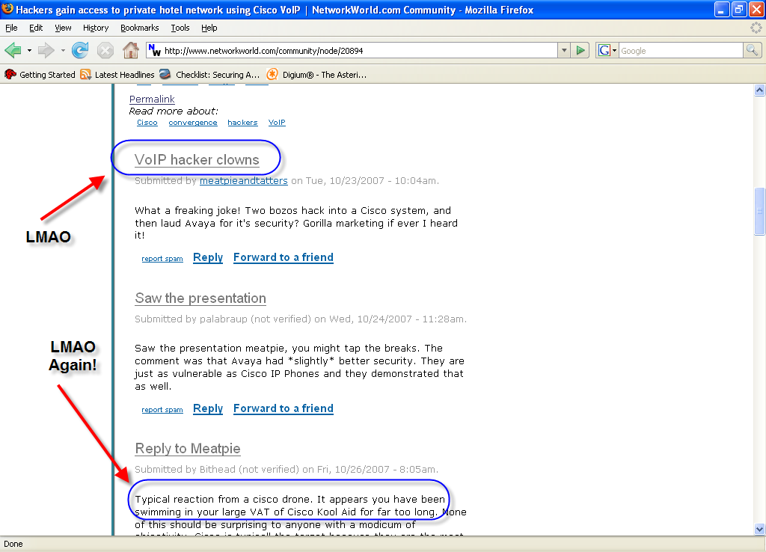
VoIP Hacker Clowns

Slide 28

VHC (VoIP Hacker Clowns)

Slide 29
Q&A

